Slide 1
UNIT II
Critical Thinking
Critical thinking is the ability to think in an organized and rational manner in order to understand connections between ideas and/or facts. It helps you decide what to believe in.
In other words, it’s “thinking about thinking”—identifying, analyzing, and then fixing flaws in the way we think.

Slide 2
1. Decision Making
Types of Key Decision-making Skills
Problem-solving
Collaboration
Emotional Intelligence
Logical Reasoning

Slide 3
More decision-making Skills
Apart from the key decision-making skills, these skills sharpen one’s ability to make good decisions.
Organization
Time management
Leadership
Creativity
Ethics
Research
Analysis
Flexibility

Slide 4
Decision-making Process
Seven-step Process
Identify the problem
Do some digging
Think creatively
Evaluate your options
Make the decision
Act on your decision
Look back

Slide 5
Types of decision-making
Intuition
Logic
Cognitive Bias
Confirmation
Anchoring
The halo effect
Over-confidence

Slide 6
Factors leading to poor decision-making
Inadequate information
Information overload
Too many people
Vested interest
Resistance to change
No attachment

Slide 7
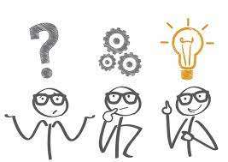
2. Problem Solving Skills

Slide 8
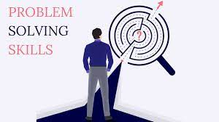
Problem Solving Skills
Problem solving is all about using logic, as well as imagination, to make sense of a situation and come up with an intelligent solution.
In fact, the best problem solvers actively anticipate potential future problems and act to prevent them or to mitigate their effects.

Slide 9
Problem Solving and Associated Skills
Problem-solving abilities are connected to a number of other skills, including:
Analytical skills
Innovative and Creative thinking
A lateral mindset
Adaptability and flexibility
Level-headedness
Initiative
Resilience (in order to reassess when your first idea doesn’t work)
Teamworking (if problem solving is a team effort)
Influencing skills (to get colleagues, clients and bosses to adopt your solutions).

Slide 10
Steps in Problem-Solving Process
1. Identify the problem
2. Do your research
3. Look for possible solutions
4. Make a decision
5. Put that decision into action
6. Await results.

Slide 11
Improving problem-solving skills
Focus on the solution
Clearly define the problem
Agree on a process
Be sure to use active listening

Slide 12
How will employers assess your problem-solving skills?
Your problem-solving abilities can be assessed in three ways:
Competency-based application and interview questions about problem solving
Hypothetical interview questions about problem solving
3. Problem solving exercises and tests

Slide 13
Technique
Keep in mind this problem-solving technique
If you’re provided with a scenario or a case study during the graduate recruitment process, you could try using the IDEAL model, described by Bransford and Stein in their book Ideal Problem Solver. It breaks down what you need to do to solve a problem into stages:
Identify the issue
Define the obstacles
Examine your options
Act on an agreed course of action
Look at how it turns out, and whether any changes need to be made.

Slide 14

3. Negotiation Skills

Slide 15
Negotiation
Negotiation is a method by which people settle differences.
It is a process by which compromise or agreement is reached while avoiding argument and dispute.
In any disagreement, individuals understandably aim to achieve the best possible outcome for their position (or perhaps an organisation they represent).
However, the principles of fairness, seeking mutual benefit and maintaining a relationship are the keys to a successful outcome.

Slide 16
Stages of Negotiation
The process of negotiation includes the following stages:
Preparation and Planning
Definition and Ground Rules
Clarification and Justification
Bargaining and Problem Solving
Closure and Implementation

Slide 17
Professional Skills of a Successful Negotiator
Empathy
Clarity on your goals
A relaxed attitude
Knowing how to add value
Listening and asking questions
Situational awareness
Reading between the lines
Embracing ‘The Pause’
Knowing your value
A Collaborative mindset
Emotional Detachment
Self-Awareness
A Strategic Mind
Emotional Intelligence

Slide 18
4. Conflict Resolution
What is Conflict?
“An expressed struggle between at least two interdependent parties who perceive incompatible goals, scarce resources, and interference from the other party in achieving their goals”.

Slide 19
Causes of Conflict at Work
Unclear responsibilities
Competition for resources
Different interests

Slide 20
Types of Conflict at Workplace
Personality Conflict
Substantive Conflict

Slide 21
Why should you resolve conflicts?
To understand more about those whose ideas, beliefs, and backgrounds may be different from your own. In order to resolve a conflict, you'll need to look at the conflict from your opponent's point of view and learn more about this person or group's perspective and motivations.
To ensure that your relationships with opponents continue and grow. If you make peace with your opponents, you increase your own allies in the community. Successful negotiations pave the way for smooth relationships in the future.
To find peaceful solutions to difficult situations. Full-blown battles use up resources -- time, energy, good reputation, motivation. By negotiating, you avoid wasting these resources, and you may actually make new allies and find new resources!

Slide 22
How should you resolve a conflict?
There are seven steps to successfully negotiating the resolution of a conflict:
Understand the conflict
Communicate with the opposition
Brainstorm possible resolutions
Choose the best resolution
Use a third party mediator
Explore alternatives
Cope with stressful situations and pressure tactics

Slide 23
5. Creative Thinking
Creative thinking is our ability to look at ideas presented or a scenario, and find new alternatives that solves the problem.
It is important to start with a clear definition of what we mean by creativity, as there are two completely different types. The first is technical creativity, where people create new theories, technologies or ideas. The second is artistic creativity, which is more born of skill, technique and self-expression.

Slide 24
Business Dictionary
A way of looking at problems or situations from a fresh perspective that suggests unorthodox solutions. Creative thinking can be stimulated both by an unstructured process such as brainstorming, and by a structured process such as lateral thinking.
Creativity is, therefore, our ability to form something new out of what’s presented. It’s our ability to think differently and provide new angles and perspectives to a solution. This can translate into a new solution that wasn’t there or even the realization that a problem doesn’t need a solution at the moment or at all.

Slide 25
Need for Creative Thinking
Thinking creatively provides immense freedom.
When we create, we have the opportunity to engage with the world without judging ourselves. It’s similar to what we felt when we were a child. Back then we didn’t care what people thought of us.
Creative thinking provides self-awareness.
We start to think with authenticity as we use our own thoughts, feelings and beliefs. This creates biases in our ideas, but we can learn to set those aside and deeply learn about ourselves.
We become more confident in our ideas.
Maybe right now, you don’t present ideas or your ideas get shut down. By tapping into creative thinking, we can build our confidence in our ideas and start to contribute to the group and our work at large

Slide 26
What are the Creative Thinking Skills?
Perception & Empathy
Analytical
Open-Mindedness
Organized
Communication
Dissect Ideas

Slide 27
How to develop Creative Thinking?
1. Brainstorm ideas
2. Role-play Scenarios
3. Reframe the issue
4. Make the most of the creative flow
5. Stay open-minded and flexible
6. Keep your ego out of it

Slide 28
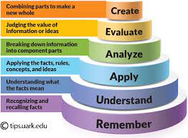
6. Bloom’s Taxonomy

Slide 29
What is Bloom’s Taxonomy?
Bloom’s taxonomy is a framework for learning, teaching and educational achievement in which each level depends on the one below. It is often depicted in the form of a pyramid.
While it initially aided in the assessment of students, it quickly became a tool for teachers to devise their curriculum, outline clear learning objectives, and design classroom activities.

Slide 30
History
Benjamin Bloom and several of his peers developed Bloom’s Taxonomy in 1956 to better assess college student performance.
Bloom’s Taxonomy consists of six different levels of learning that build on one another to guide students and educators through the stage of educational attainment.

Slide 31
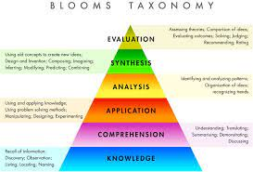
Original Pyramid

Slide 32
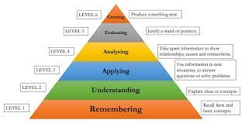
Revised Pyramid

Slide 33
Levels of Blooms Taxonomy
Level 1 – Remembering
Level 2 – Understanding
Level 3 – Applying
Level 4 – Analyzing
Level 5 – Evaluating
Level 6 - Creating

Slide 34
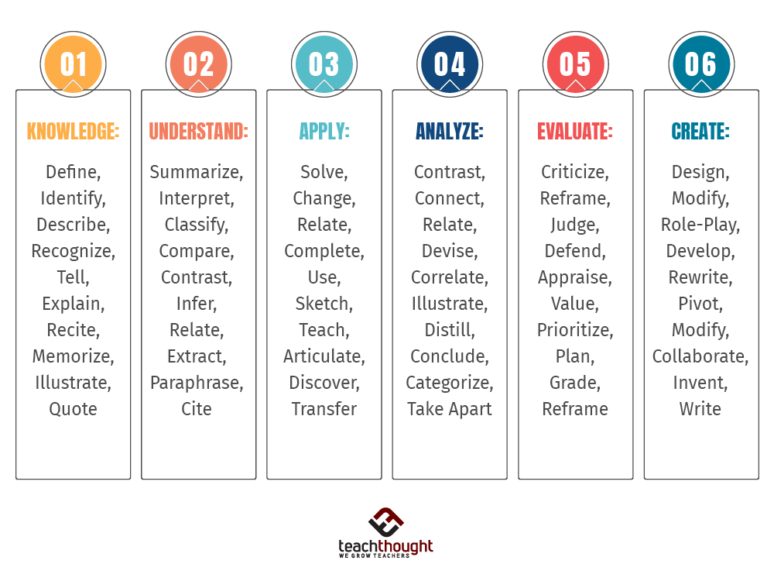
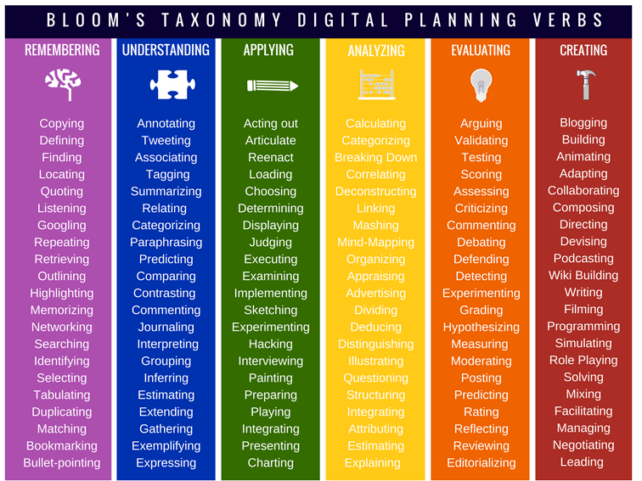

Slide 35
Domains of Blooms Taxonomy
1: The cognitive domain (learning and understanding)
2: The affective domain (feelings and emotions)
3:The psychomotor domain (manual and Physical Skills)

Slide 36
Thank you

